Slide 1
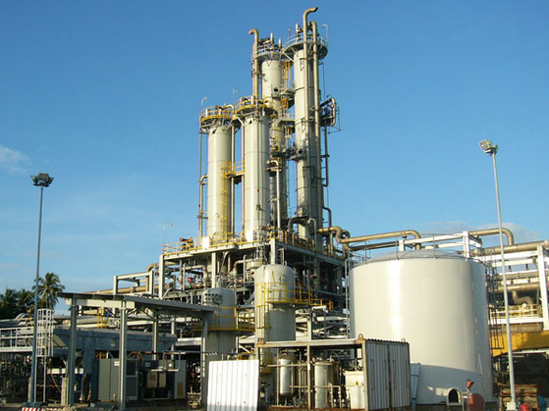
ARB GHG Oil & Gas Regulation
Santa Barbara County APCD
November 7 – Santa Maria
November 14 – Santa Barbara
(revised on 11/21/17)

Slide 2
Today’s Presentation
Purpose of the ARB Regulation
Who is Impacted?
Requirements
Rule 331 LDAR Exemptions
Implementation: MOA, Permits, Fees, Enforcement
Key Deadlines
Webpage & Resources

Slide 3
Purpose of the ARB Regulation
AB 32. California Global Warming Solutions Act.
Purpose is to reduce methane (CH₄) emissions.
Short-Lived Climate Pollutant (SLCP) Strategy target to reduce methane emissions from the oil & gas sector by 40-45 percent as a whole by 2025.
SB 887. Natural gas underground gas storage.
SB 4. Oil & gas well stimulation.
ARB’s regulation covers leaking equipment from compressor seals/rod packing to piping components such as valve and flanges.

Slide 4
Who is impacted?
Facilities that are impacted:
Oil and Gas Production, Processing, and Storage
Gas Processing Plants
Natural Gas Underground Storage Fields
NG Gathering and Boosting Stations
NG Transmission Compressor Stations
Crude Oil Pipeline Pump Stations
Facilities that are not impacted:
Utility Odorant & Metering Stations
Oil & Gas Platforms on the Outer Continental Shelf

Slide 5
Requirements
Separator and Tank Systems
Circulation Tanks for Well Stimulation Treatments
Natural Gas Compressors
Natural Gas Powered Pneumatic Devices and Pumps
Liquids Unloading of Natural Gas Wells
Well Casing Vents
Natural Gas Underground Storage Facilities
Leak Detection and Repair (LDAR), including Critical Components
Vapor Collection Systems and Vapor Control Devices
Recordkeeping and Reporting

Slide 6
Separator and Tank Systems
Definition: means the first separator in a crude oil or natural gas production system and any tank or sump connected directly to the first separator.
Includes upstream gauge tanks.
Applies to uncontrolled systems.
Exempted if already connected to a permitted Vapor Collection System (VCS).
Flash testing required to determine methane emissions.
VCS required if the annual emissions are above 10 metric tons methane.
Exemptions for low throughput systems and small gauge tanks.

Slide 7
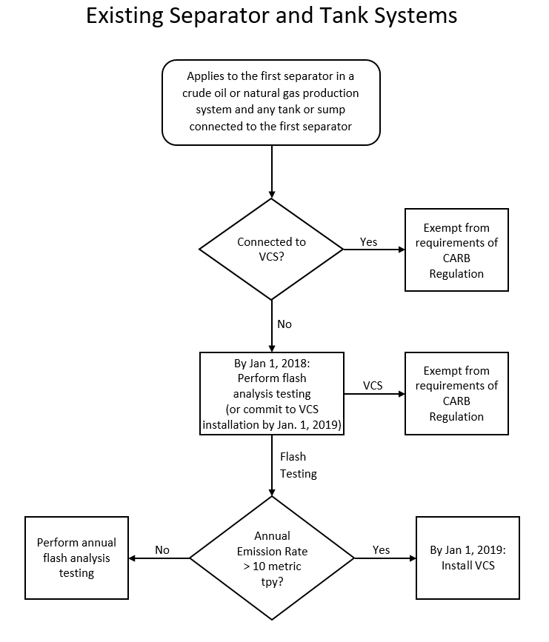

Slide 8
Circulation Tanks for Well Stimulation Treatments
Best Practices Management Plan required
Inspection practices to minimize emissions from circulation tanks.
Practices to minimize venting of emissions from circulation tanks.
Practices to minimize the duration of liquid circulation.
Alternative practices to control vented and fugitive emissions.
Requires a technology assessment by Jan. 1, 2019.
Use of a VCS with 95% capture and control.
Allows for pooled testing amongst operators.
ARB will evaluate results of testing.
ARB will determine if VCS controls are required for these operations by July 1, 2019.

Slide 9
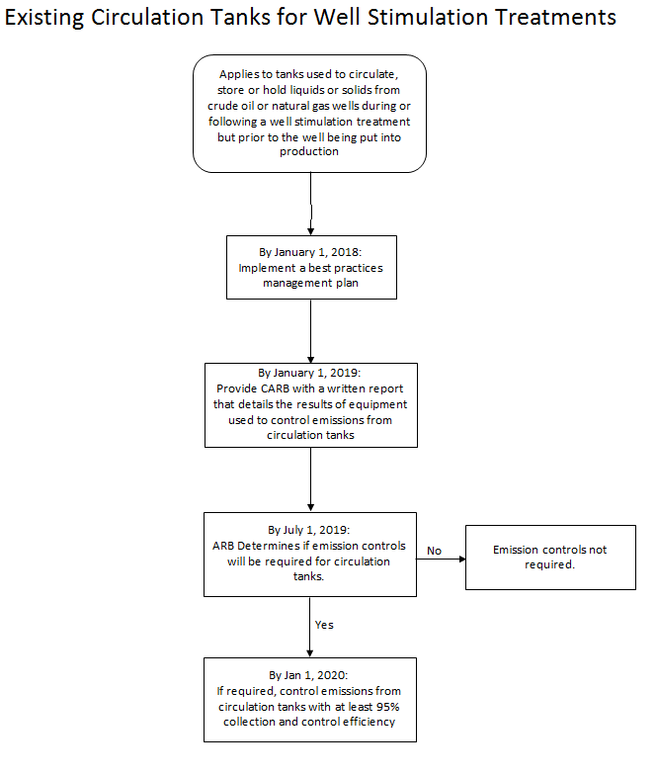

Slide 10
Natural Gas Compressors
Reciprocating Natural Gas Compressors
200 hour/year exemption
LDAR required
Seal/Rod Packing Standards
Production:
Install VCS or meet LDAR limits.
Processing/Transmission/Storage:
Install VCS or Annually measure leak rates and meet limits
In compliance if already connected to permitted VCS
Centrifugal Natural Gas Compressors
200 hour/year exemption
LDAR required
Install VCS or Annually measure leak rates and meet limits
In compliance if already connected to permitted VCS
Vapor Recovery Compressors. Typically are sliding vane (exempted) or reciprocating (subject to regulation). Other types…

Slide 11
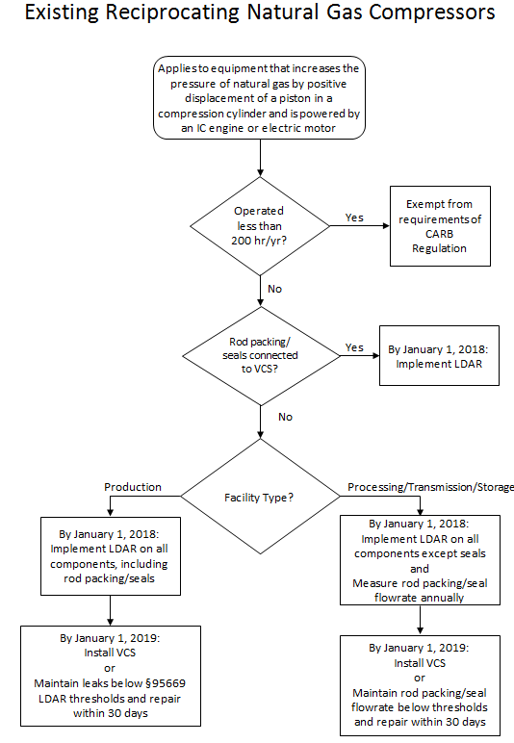

Slide 12
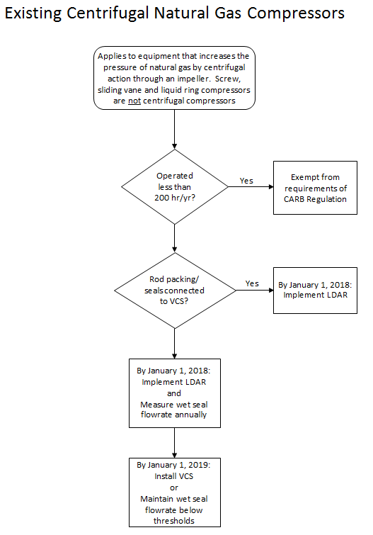

Slide 13
Natural Gas Powered Pneumatic Devices and Pumps
A pneumatic pump is not a pneumatic device.
Bifurcated b/n continuous bleed and intermittent bleed
Standards for devices and pumps
Pneumatic devices installed prior to 2016
Cease venting to atmosphere by January 1, 2019, or
Annually measure leak rates and meet limits
LDAR.
Intermittent bleed devices: January 1, 2018
All others: January 1, 2019
All NG pneumatic pumps phased out by January 1, 2019

Slide 14
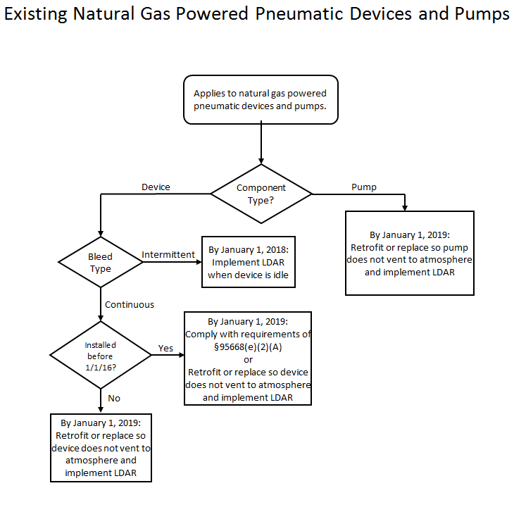

Slide 15
Liquids Unloading of Natural Gas Wells
Natural gas wells do not include wells that produce crude oil emulsion.
Three options to comply:
Connect to VCS
Measure volume of gas vented by direct method
Calculate the amount of gas vented

Slide 17
Well Casing Vents
Requires annual direct measurement of NG from well casing vents open to the atmosphere.
District Rule 325 (Crude Oil Production and Separation):
Prohibits venting of NG from casing vents, whether opened continuously or intermittently.
Does not apply to wells that are undergoing routine maintenance.

Slide 18
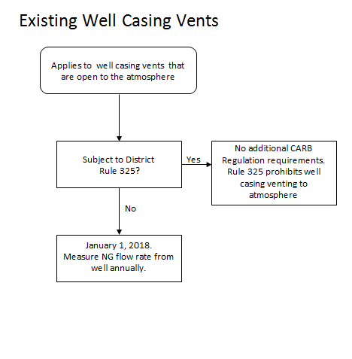

Slide 19
Leak Detection and Repair LDAR
How are facilities subject to local LDAR rules handled?
Whose LDAR rule applies when NG Compressor and NG Pneumatics sections cite the ARB LDAR requirements?
Do facilities that are exempt from Rule 331 have to submit an Inspection & Maintenance Plan?
What happens to components exempted under Section B of Rule 331? Produced water lines? Utility natural gas lines?
Can I retract my prior Rule 331 exemptions? How and when?
Which Rule 331 exemptions should I retract to avoid having to implement two LDAR programs?
B.2.a – Natural Gas (partial request)
B.3.b – Process fluids < 10 ROC by wt. (partial request)
B.3.c – Totally contained or enclosed
B.3.e – NG Pneumatic control valves

Slide 20
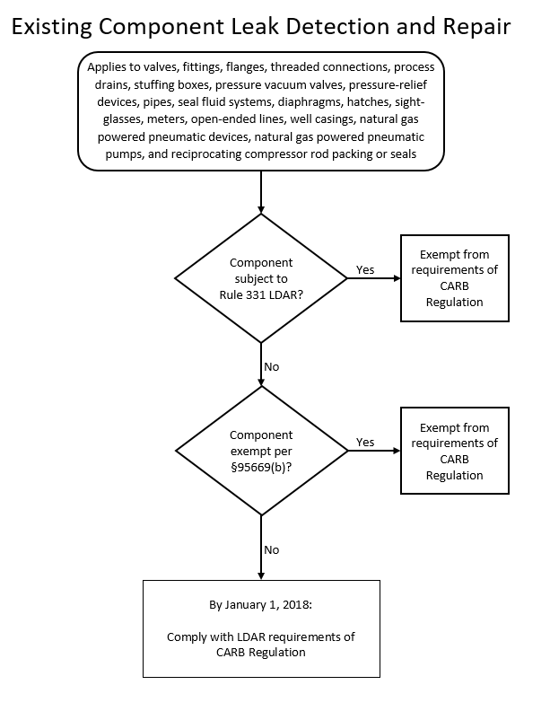

Slide 21
Rule 331 LDAR Exemptions

Slide 22
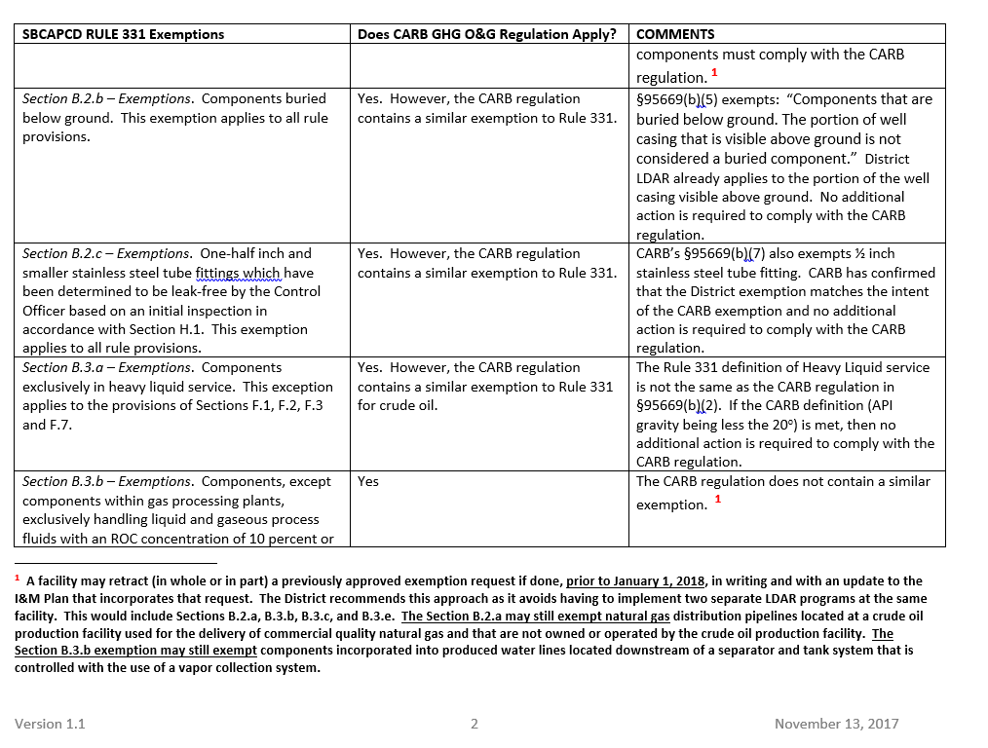

Slide 23
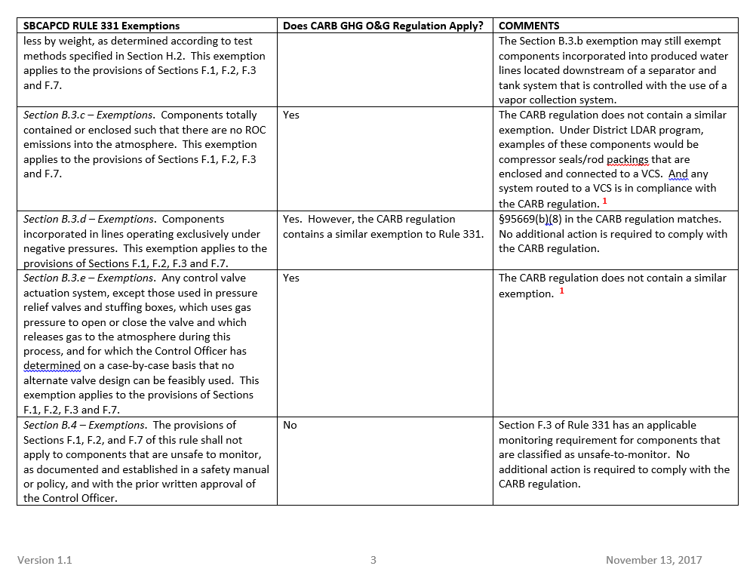

Slide 24
Critical Components
District retains critical component determinations for components subject to local LDAR rule.
This applies to prior as well as future determinations.
All critical components must be listed in the District approved I&M Plan for the facility/source.
ARB makes critical component determinations for components subject to the ARB regulation (unless otherwise noted in the ARB/District MOA)

Slide 25
Vapor Collection Systems and Vapor Control Devices
VCS systems servicing Separator and Tank Systems that are permitted as of January 1, 2018 are exempt.
Section (d) Low NOx requirements do not apply to:
NG compressor vents and/or NG pneumatics that are currently connected to a VCS.
Replacement separators, tanks, compressors that are currently connected to a VCS.
New devices that are subject to NSR and will be connected to a VCS.
Section (d) Low NOx requirements do apply when:
The operator needs to install a flare in order to comply with the regulation’s VCS requirements.
Operators of an existing facility already with a flare are required to control additional vapors in order to comply with the regulation.

Slide 26
Recordkeeping and Reporting
Records are required for equipment/components subject to the regulation.
Recordkeeping/Reporting required for:
Production data, reagrdless if separator/tank connected to VCS.
LDAR records for components subject to local rule (per local rule).
Recordkeeping/Reporting is required for:
Flash testing data.
Circulation tank BPM Plan.
LDAR records for components not subject to local rule.
NG compressor emission flow rate measurements/other.
NG pneumatic emission flow rate measurements.
Liquids unloading from NG well information.
Well casing emission flow rate data.
All Underground NG Storage facility required data.
Initial Compliance Status Reports due January 1, 2018, the annually.
ARB regulation reports due July 1 to the District, then...
District will align reporting to match existing permits at renewal.

Slide 27
Implementation
District/ARB Memorandum of Agreement (in process).
District will implement and enforce the ARB regulation.
Exceptions: Circulation tank study, Monitoring Plan approval for NG Underground Storage, and Critical Components.
No Registration program. Existing permits already list the equipment subject to the regulation.
Initial January 1, 2018 report for facility compliance per Section 95674(b)(2)(A). GHG Compliance Status Checklist Long/Short Form.
Permit renewal process will incorporate terms of regulation.
Permits are required for modifications or new controls.
No new fees. Existing fee schedule works.
Cost reimbursement provisions will be set up for implementation of NG Underground Storage requirements.
On case-by-case basis, cost reimbursement to be used for facilities subject to ARB regulation LDAR requirements.

Slide 28
Key Deadlines
Now: Revise your District I&M Plan (retract R331 exemptions).
Now: Complete a GHG Compliance Status Checklist for each facility. Use either the Long/Short form. Submit to District.
January 1, 2018:
Revise local I&M Plans (optional)
Initial Section 95674(b)(2)(A) reports (Long/Short Form).
Comply with LDAR requirements (Table 1/2 standards).
Flash testing results due.
Obtain Critical Component pre-approvals.
Circulation tank Best Practices Management Plan in place.
Measure seal/packing flow rates. (annual requirement)
Submit Monitoring Plan for NG Underground Storage sites.
Measure gas volumes: open well casing vents/NG well unloading.

Slide 29
Key Deadlines (Continued)
January 1, 2019:
Updates to Section 95674(b)(2) Reports (wells, production data, equipment list changes)
Install VCS on uncontrolled Separators/Tanks (> 10 mt/yr).
Provide ARB report on circulation tanks.
NG Compressors: Comply with standards or install VCS.
NG Pneumatics: Retrofit or replace.
Implement Monitoring Plan at NG Underground Storage sites.
Continue required flash tests and flow rate measurements.
January 1, 2020:
Updates to Section 95674(b)(2) Reports.
Comply with LDAR requirements (Table 3/4 standards).
Install VCS on circulation tanks (per ARB direction).
Continue required flash tests and flow rate measurements.

Slide 30
Webpage & Resources
Oil & Gas Webpage https://www.ourair.org/oil-and-gas/
This PowerPoint Presentation
Regulation Flow Diagrams.
Separator and Tank Systems, NG Reciprocating Compressors, Circulation Tanks, NG Centrifugal Compressors, NG Powered Pneumatics, Liquids Unloading NG Wells, Well Casing Vents, Component LDAR.
Fact Sheet (pdf)
FAQ (pdf)
Rule 331 LDAR Exemption Comparison Table (pdf)
GHG Compliance Status Checklist (Long / Short PDF Forms)
ARB Final Regulation Order https://www.arb.ca.gov/regact/2016/oilandgas2016/ogfro.pdf
ARB Oil & NG Production, Processing, and Storage Webpage https://www.arb.ca.gov/cc/oil-gas/oil-gas.htm

Slide 31
Contacts
Michael Goldman. GoldmanM@sbcapcd.org. 961-8821
David Harris. HarrisD@sbcapcd.org. 961-8824
William Sarraf. SarrafW@sbcapcd.org. 961-8888
Kevin Brown. BrownK@sbcapcd.org. 961-8826

Slide 32
Questions

